Slide 1
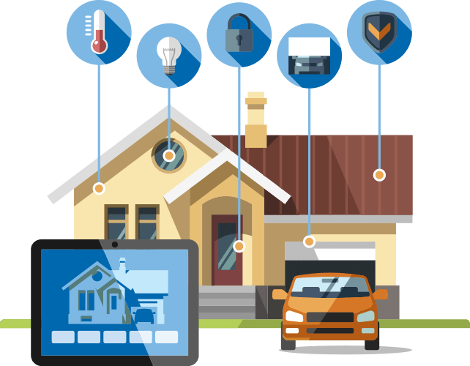
SMART HOME SIMULATOR
Creator: HUU TAM NGUYEN

Slide 2
CONTENT
Idea of the application.
The knowledge is used.
Introduce smart home simulator.
Completed and missing parts.
Demo.

Slide 3
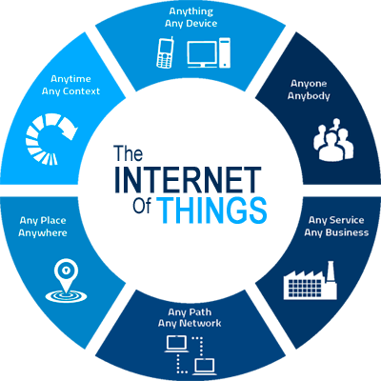
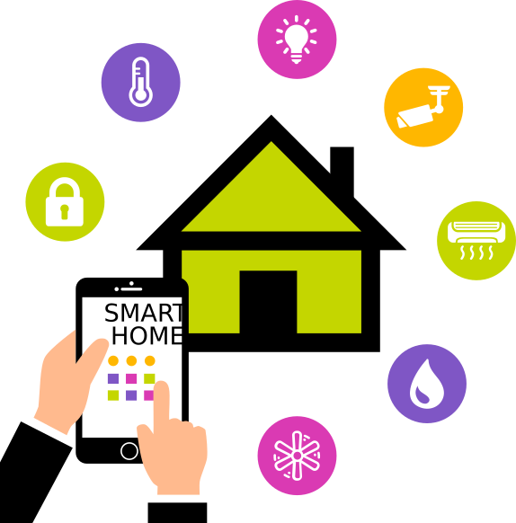

IDEA OF THE APPLICATION
The development of Internet of thing.
Human needs.

Slide 4
THE KNOWLEDGE IS USED
C++ programming.
Design database with c++, used sqlite3 lib.
Working with socket.
Design UI with qtcreator c++.
Create document with doxygen.

Slide 5
SMART HOME SIMULATOR
The design for smart home simulator system

Slide 6
SMART HOME SIMULATOR
THE COMPONENTS OF SMART HOME SIMULATOR
Server.
Gateway.
Light.
Door.
Fan.
Mobile.

Slide 7
SMART HOME SIMULATOR
SERVER
Create IP address simulator for each client connected
Receive and response the requests from client.

Slide 8
SMART HOME SIMULATOR
GATEWAY
Controls and manages connections between server and client

Slide 9
SMART HOME SIMULATOR
LIGHT
Turns on or turns off itself
Adjusts the level of brightness.
It can be controlled by the mobile.

Slide 10
SMART HOME SIMULATOR
DOOR
Close or open itself
It can be controlled by the mobile.

Slide 11
SMART HOME SIMULATOR
FAN
Turns on or turns off itself
Adjusts the level of speed.
It can be controlled by the mobile.

Slide 12
SMART HOME SIMULATOR
MOBILE
Connect to server.
Controls devices of smart home which is being connected to server.

Slide 13
COMPLETED AND MISSING PART
The gateway is not implemented.

Slide 14
DEMO
The design for smart home simulator system

